Slide 1
IMAGING IN OBSTETRICS
Dr. SHEEBA. S ASSISTANT PROFESSOR, DEPT OF OBG

Slide 2
Introduction:
During the past century, imaging of the pregnant patient has been performed with radiography, scintigraphy, computed tomography, magnetic resonance imaging, and ultrasonography (US). US imaging has emerged as the primary imaging modality, because it provides real-time images at relatively low cost without the use of ionizing radiation.

Slide 3
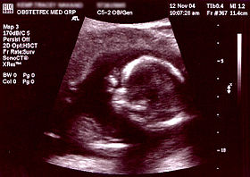
ULTRASOUND IN OBSTETRICS
Obstetric ultrasound uses sound waves to produce pictures of a baby (embryo or fetus) within a pregnant woman, as well as the mother's uterus and ovaries. It does not use ionizing radiation, has no known harmful effects, and is the preferred method for monitoring pregnant women and their unborn babies.

Slide 4
ULTRASOUND IN OBSTETRICS
Obstetrical ultrasound provides pictures of an embryo or fetus within a woman's uterus, as well as the mother's uterus and ovaries.
A Doppler ultrasound study may be part of an obstetrical ultrasound examination.
During an obstetrical ultrasound the examiner may evaluate blood flow in the umbilical cord or may, in some cases, assess blood flow in the fetus or placenta.

Slide 5
Indications:
Unsure last menstural period
Vaginal bleeding during pregnancy
Postdate fetus
Intrauterine growth retardation
Twins
Obstetrical complication in prior pregnancy
Screen for fetal anomaly

Slide 6
USES :
establish the presence of a living embryo/fetus
estimate the age of the pregnancy
diagnose congenital abnormalities of the fetus
evaluate the position of the fetus
evaluate the position of the placenta
determine if there are multiple pregnancies
determine the amount of amniotic fluid around the baby
check for opening or shortening of the cervix
assess fetal growth
assess fetal well-being
Some physicians also use 3-D ultrasound to image the fetus and determine if it is developing normally.

Slide 7
Limitations:
Obstetric ultrasound cannot identify all fetal abnormalities. Consequently, when there are clinical or laboratory suspicions for a possible abnormality, a pregnant woman may have to undergo nonradiologic testing such as a blood test or amniocentesis (the evaluation of fluid taken from the sac surrounding the fetus) or chorionic villus sampling (evaluation of placental tissue) to determine the health of the fetus, or she may be referred by her primary care provider to a perinatologist (an obstetrician specializing in high-risk pregnancies).

Slide 8
1st trimester (9-12 weeks)
During the first trimester, the pregnancy progresses from a tiny gestational sac with no visible embryo, to an ~80 mm fetus with identifiable features and internal organs.
ultrasound findings in early pregnancy:
Ultrasound during this period is predominantly concerned with the following clinical issues:
confirming intrauterine pregnancy (IUP)
early features supportive of an intrauterine pregnancy
double decidual sac sign
intradecidual sign
double bleb sign.

Slide 9
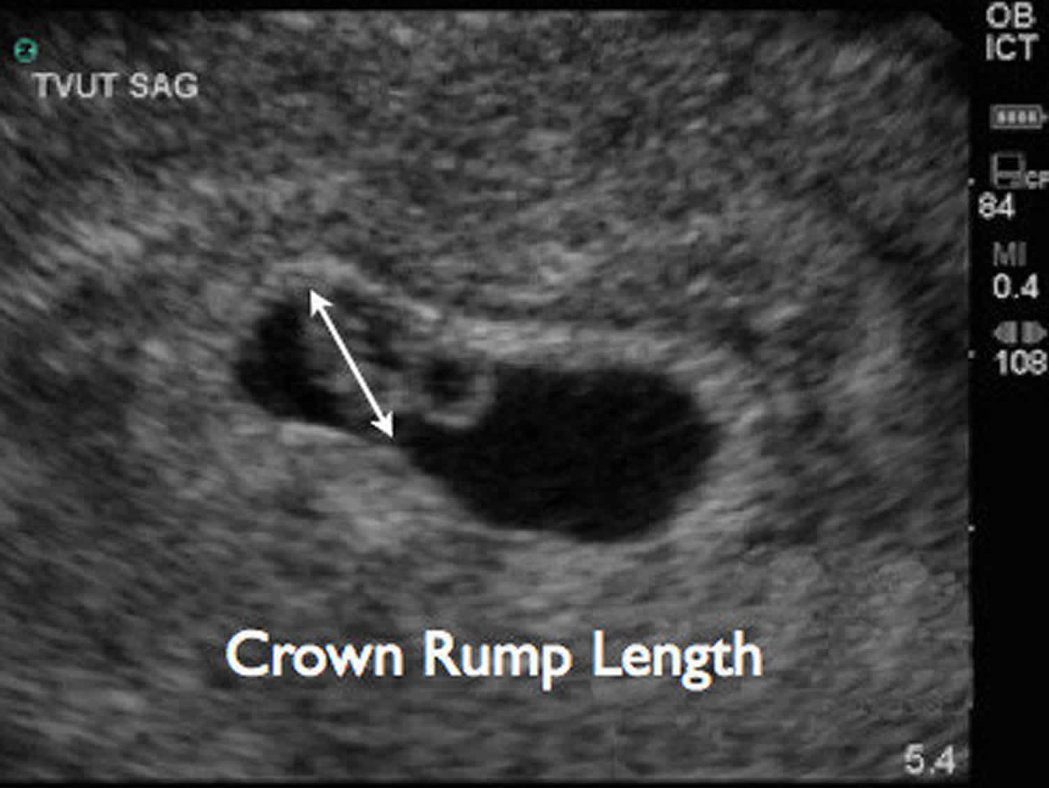
Dating of the pregnancy
crown rump length (CRL) measurement is most accurate, however if no fetal pole is seen, the mean sac diameter (MSD) may be used.

Slide 10
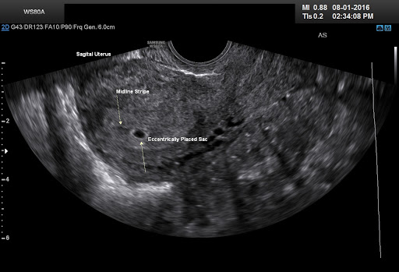
Gestational sac

Slide 11
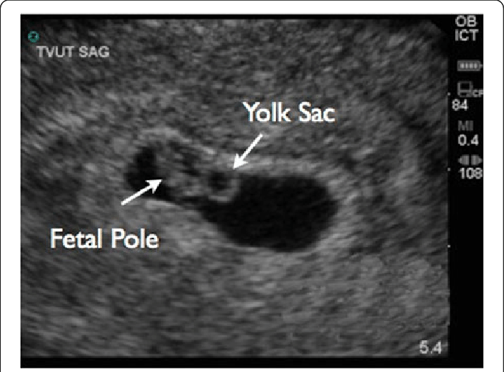
Presence of yolk sac or fetal pole with gestational sac confirms pregnancy

Slide 12
Pseudogestational sac or pseudosac

Slide 13
Double decidual sac sign
The double decidual sac sign (DDSS) is a useful feature on early pregnancy ultrasound to confirm an early intrauterine pregnancy (IUP) when the yolk sac or embryo is still not visualized. ... Where the two adhere is the decidua basalis, and is the site of future placental formation.

Slide 14
Intradecidual sign

Slide 15
Double bleb sign
A double bleb sign is a sonographic feature where there is visualization of a gestational sac containing a yolk sac and amniotic sac giving an appearance of two small bubbles . The embryonic disc is located between the two bubbles.

Slide 16
assessment of suspected early pregnancy failure:

Slide 17
assessment of suspected ectopic pregnancy:

Slide 18
Antenatal screening for aneuploidy (nuchal lucency measurement)

Slide 19
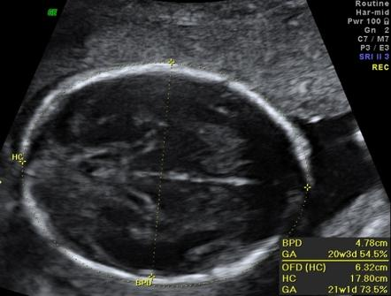
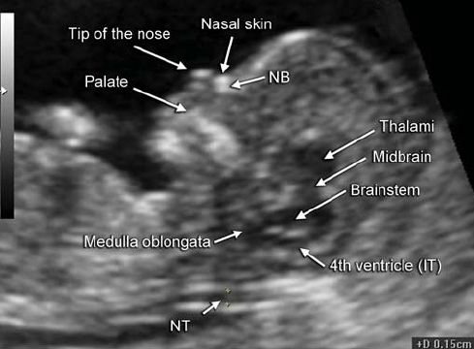
Second trimester ultrasound
fetal biometry
basic biometry
biparietal diameter (BPD)
head circumference (HC)
abdominal circumference (AC)
femur length (FL)
fetal morphology assessment
fetal echocardiography views

Slide 20
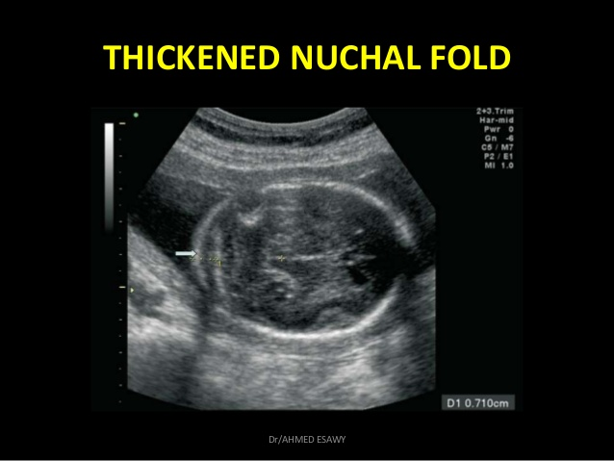
soft markers
nuchal fold thickness
ventriculomegaly
absent nasal bone
hypoplastic nasal bone
echogenic intracardiac focus
choroid plexus cysts
echogenic bowel
aberrant right sublavian artery
placenta
low lying placenta
placental abruption

Slide 21
ventriculomegaly

Slide 22
Absent nasal bone

Slide 23
placental abruption

Slide 24
Indications of second and third trimester usg:
Gestational age
Cervical insufficiency
Suspected multiple pregnancy
Liquor volume
Placenta previa
Suspected uterine malformations
Cases with premature rupture of membrane
Fetal growth
Fetal presentation
Fetal well being
Screening fetal anomalies
Uterine sizes

Slide 25
Liquor volume:

Slide 26
Fetal age estimation:

Slide 27
Fetal growth:

Slide 28
Fetal well being:

Slide 29
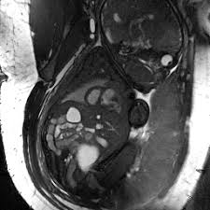
MAGNETIC RESONANCE IMAGING (MRI)
It is useful to obtain high soft tissue contrast and acquisition of images in axial,sagittal and coronal planes.
MRI is devoid of any ionizing radiation and found to have no fetal harmful effect at any gestational age with 1.5 tesla strength.

Slide 30
INDICATIONS:
Assessment of cephalopelvic disproportion during
second and third trimester
Siamese fetuses
Lung and pelvic masses
Placenta previa workup

Slide 31
Contraindications:
Internal cardiac pacemaker.
Implanted defibrillator.
Implant or other metals in body.

Slide 32
Early pregnancy MRI

Slide 33
Second trimester MRI:

Slide 34
Third trimester in MRI:

Slide 35
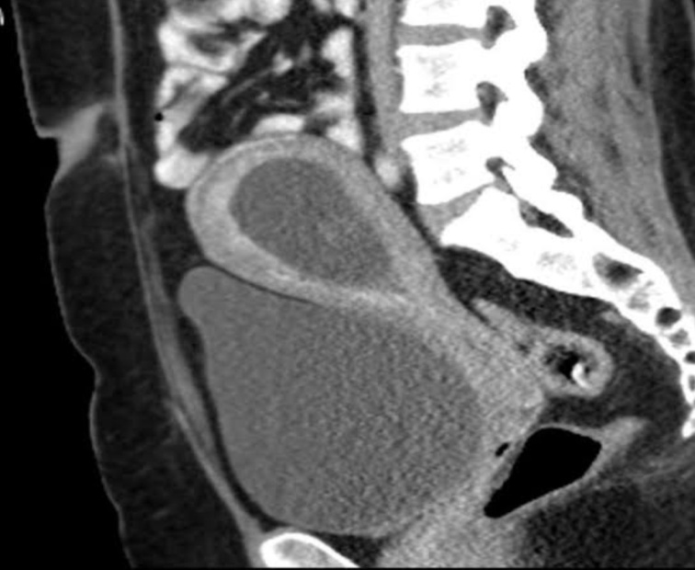
Computed tomography in obstetrics:
CT imaging is done by obtaining a spiral 360 degree images that are processed in multiple planes.
CTscan allow forfor cross sectional view of body tissue and organ.CT scan while pregnant first trimester has the highest risk to the developing foetus due to the carcinogenic and teratogenic effects of the ionizing radiation.
An abdominal condition that requires a CAT scan exposes the foetus to high levels of radiation.The amount of exposure depend on maternal and fetal size, fetal position distance from the radiation.

Slide 36
CT of a pregnant women shows normal fetus:

Slide 37
USES:
CranialCranial CT : detect acute haemorrhage in eclamptic women
CT pelvimetry
Abdominal CT : done as if fetus is dead
Evaluate brain, liver,pelvicpelvic metastasis in GTD
Diagnosis of DVT
Diagnosis of acute neurological catastrophy during pregnancy

Slide 38
X-RAY:
INDICATION:
Fetal: congenital malformation of fetus and neonates, skeletal malformation, birth injury like fracture or dislocation and secondary abdominal pregnancy
Maternal: patient having cardiopulmonary disease may require X-RAY chest during pregnancy and that should be done beyond 12 weeks

Slide 39
X-ray of Twin pregnancy :

Slide 40
RADIATION HAZARDS:
Teratogenecity
Oncogenecity
Genetic damage
Intrauterine death
Can cause morbidity like FGR, geneticmutations, neurologic abnormalities, mentalretardation, childhood leukemia and alsomortality.
High risk in first trimester.

Slide 41
THANK YOU

